Slide 1

Adopted from MIT Course
ELECTRICAL RESISTANCE
FISIKA DASAR 2

Slide 2
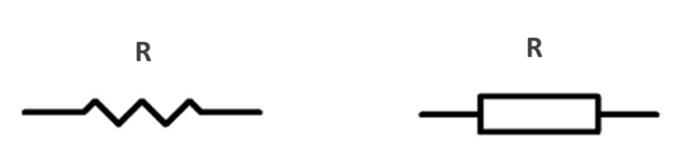
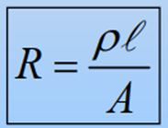

Definition of Electrical Resitance
Electrical resistance is a measure of how difficult it is for electric current to flow in a conductor.
Several electrical devices used in circuits are designed to impede the flow of current and are called resistors.
The symbol for electrical resistance is R, and the SI unit is ohms (Ω).
Where
R = Resistance
𝛒 = resistivity (units are 𝛺m)
L = length of the path through the material
A = cross sectional area of the material
Adopted from MIT Course
2

Slide 3
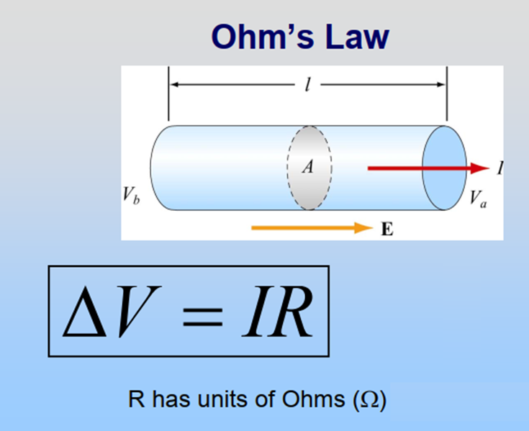
Ohm’s law states that the potential difference between two points on a conductor is proportional (directly related) to the electric current flowing through the conductor.
Adopted from MIT Course
3

Slide 4
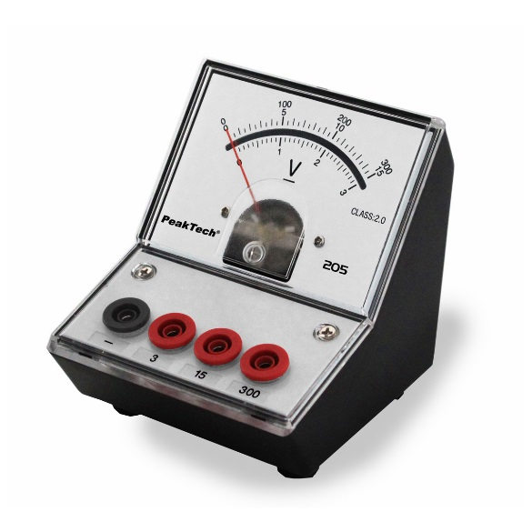
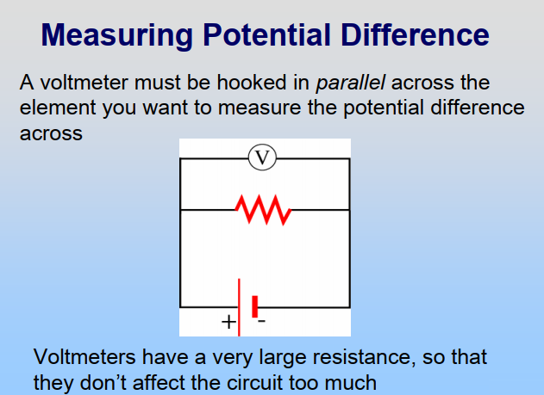
Adopted from MIT Course
4

Slide 5
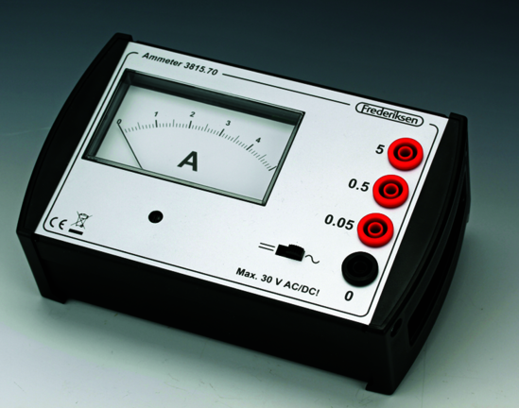
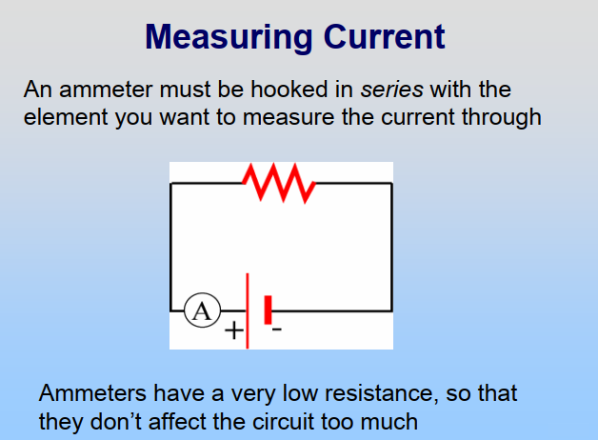
Adopted from MIT Course
5

Slide 6
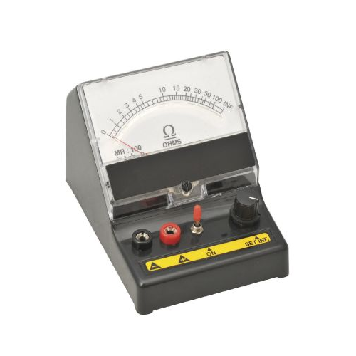
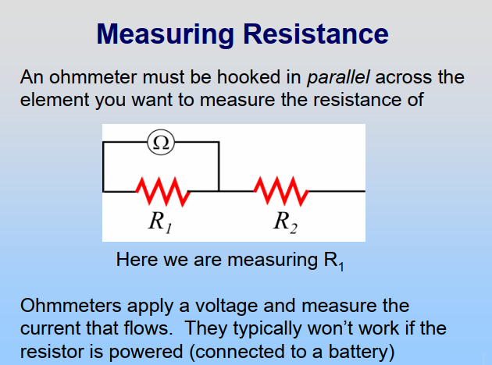
Adopted from MIT Course
6

Slide 7
Example 1
A copper wire is 20 m long with a diameter of 2 mm. What is the resistance of wire? If the electric current flows through the wire is 4.0 A, what is the voltage of wire? (ρ_{copper} = 1.68×10⁻⁸ Ωm)
Answer:
A = π r² = π (d/2)²
= (3.14) (2×10⁻³/2)² = 3.14×10⁻⁶ m²
V = I R
= (4) (0,11)
= 0.44 V
R = ρL/A
= (1.68×10⁻⁸) (20) / (3.14×10⁻⁶)
= 0.11 Ω
7

Slide 8
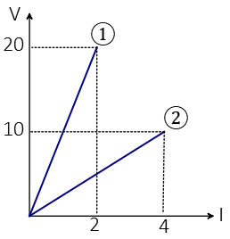
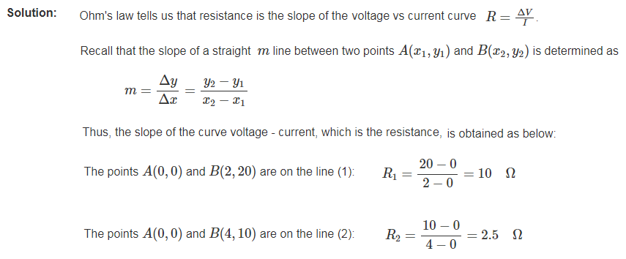
Example 2
The voltage-current curve for an ohmic conductor is plotted as shown in the figure below. What is the resistance of resistors 1 and 2?
8

